Slide 1
WorldPay and InterPayments
January 2023

Slide 2
With you today
Suzanne Vandenberg, VP Partnerships
Devin Foster, Director of Partnerships

Slide 3
Agenda
Who we are
How we talk about surcharging
How we talk about compliance
Case study – Patterson
How we can work together
Resources and SPIFF

Slide 4
InterPayments Mission
We empower companies to lower processing fees
A Single Purpose
A Technology Partner
Unique Expertise
We are NOT a payment service provider (PSP)
We help merchants offset card fees via compliant surcharging
We work alongside you to offset card fees
Surcharging is not one-size-fits-all
Surcharging is our core expertise
Trusted by Fortune 500 companies and major B2B enterprises
Notes:
Talking Points goal: Create credibility through highlighting expertise and goal alignment, our independence from a PSP, and we’re trusted by major players.
Our mission is to recover your payment processing fees using compliant surcharging technology. That’s the only thing we do.
Single Purpose
We only want to help you recover fees.
The only other surcharge offerings are from payment service providers, like payment gateways and payment processors. Many merchants wonder how we’re different from them.
Your PSP provides an essential service – they make sure you can accept payments. They deserve their fee for that. But they benefit when fees go up. Since surcharging helps fees go down, they don’t have an incentive or focus to provide a surcharge solution aligned with your needs and your customers.
A Technology Partner
We’re not a PSP. We actually partner with many PSPs because it’s not a core focus for them. As it is for us.
We’re a software partner that makes THEIR fees less expensive for YOU on a day-to-day basis. As you’ll learn, merchants use us to fit surcharging to their unique business needs. In a way PSPs cannot.
That’s because our software will work with the payment technology you already have and PSPs you already use. This minimizes the changes you have to make to surcharge. It allows you to tailor surcharging to both your exact costs, your customers, and your payment workflow.
Partnership also means aligning our incentives with yours. So we take on all of the compliance risk of surcharging in our contracts, and only make money when you recover fees. That’s also different from what a PSP offers.
Unique Expertise
We are surcharge experts because we don’t have anything else to fall back on.
Many major PSPs and merchants trust that expertise. Mastercard, Wells Fargo, Worldpay, Checkout.com, BillTrust, and some of the largest merchants across United States and Canada all rely on our surcharging solution today.

Slide 5
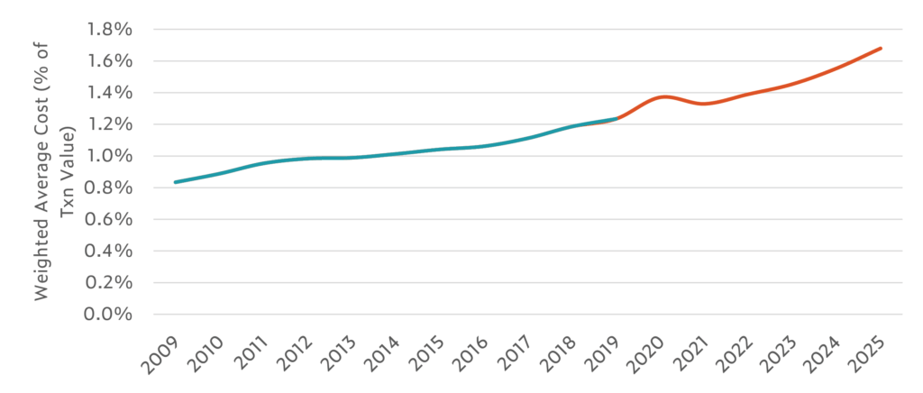
Payment costs keep rising for B2B merchants
Causes:
Increasing per transaction fees
Rising digital sales
Historic inflation
5
Source: CMSPI
Notes:
Talking Point goal: there is a cost to doing nothing about rising fees
We’re talking today because surcharging is a growing trend. It’s driven by the multi-decade trend of rising fees. There are 3 key reasons why merchants are caught up in this:
First, card fees set by the banks and card networks just keep increasing year after year, and nothing seems to stop them.
Second, digital card transactions are rising at more than 20% per year. Digital payments have a lot of benefits: lower DSO, increased sales, guaranteed funds, and fast settlement. But it comes with higher costs.
Third, inflation is causing the price of everything to go up. Higher inflation leads to higher prices leads to higher card fees.

Slide 6
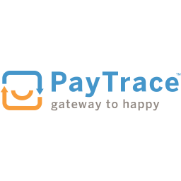
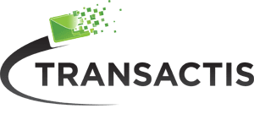
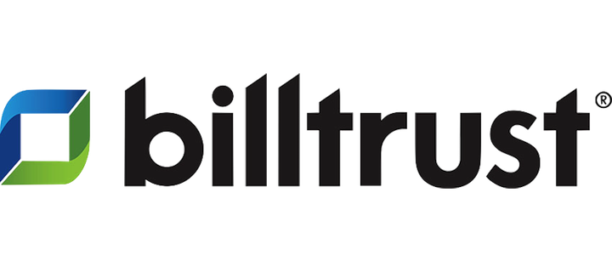
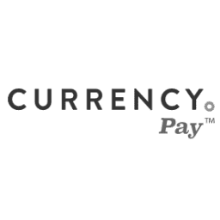
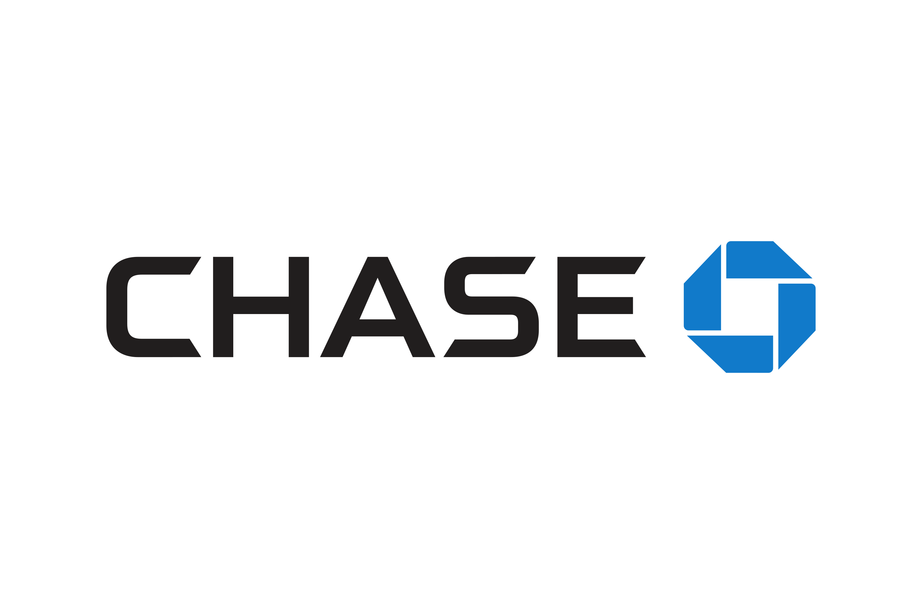
Enterprise partners and current merchant platforms
Top 3 US Bank

Slide 7
What merchants need
Surcharge partner criteria
Aligned
Seamless
Control
Compliant
Not another payment provider adding more fees
We get paid when the merchant recovers fees
Independent, API-driven solution
Surcharge wherever you accept payments today
Surcharge who, what, when, and how much you want
Reporting on savings and fees
Contractually guaranteed compliance with the 67+ surcharge regulators
ISO 27001 compliant
Notes:
Talking Points goal: (2 minutes) Create credibility by saying “we know what merchants broadly need.”
Your answers to our questions are really helpful.
There are a lot of details just under the surface of surcharging. It looks simple – just add a line item – but without considering these details from the start you could get in trouble.
As merchants understand the details, we’ve found they look for 4 things in a surcharge partner.
First, the solution is aligned with fee recovery. You save money, they make money.
Second, they want to minimize disruption to their business. They want an API that fits into their existing payment workflows.
Third, they need control and insight over when, where, how, and who gets surcharged. The business is too complicated for a one-size-fits-all solution.
Last but not least – something we’ll dig into deeply today – is compliance. This isn’t core to a merchant’s business. They want to focus on their core business by offloading the complicated, evolving risks with a secure partner.
=======
Critical question to ask at this point:
Does this align with that you’ve been looking for? Is there anything else you’ve been thinking about as you’ve looked for a solution?

Slide 8
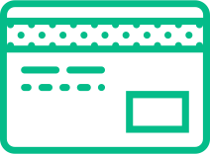
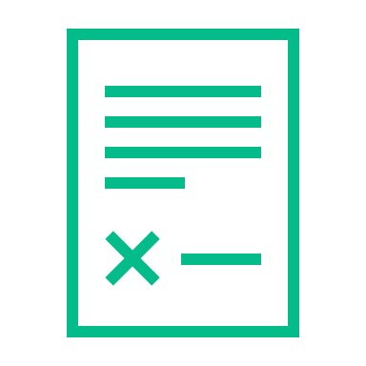
The critical components of compliance
Rate-Level Compliance
Card-Level Compliance
Automated maximizing fee recovery in accordance with maximum surcharge and customer contracts rules.
Without these, automated and compliant surcharging is impossible.
Automated management of all rules required by card networks and acquiring banks.
Without this, card networks will fine you or cut you off.
Regulatory Compliance
Indemnification and Due Diligence
Automated management of all laws and regulations required by federal, state, and provincial governments.
Without this, state attorney generals will fine or sue you.
Contractual guarantees from your surcharging provider that absolve you of surcharging risks.
Without this, you are exposed to the risks from all other categories.
Notes:
Talking points goals: Merchant understands how complicated compliance can be. Create credibility that we know what we’re doing.
The reason Acquirer solutions are non-compliant is because it is hard. We think about it in four categories:
Rate-level compliance: you have to surcharge at the correct rate. There are maximum surcharge rules, and customer contract rules around this.
Card-level compliance: automatically following the card company policies. If you don’t, they fine you. And they’re fining people more and more.
These rules conflict between card providers. And yes, these rules change all the time. A recent major change just happened in April 2023.
Regulatory compliance: automatically following the surcharging laws of the country, state and province. These rules change on a card by card basis, depending on the card’s zip code. And they conflict with card-level rules, so your surcharge system has to be able to correctly choose what to follow! Otherwise you can be open to attorney general and customer legal action and fines,.
Finally, indemnification and due diligence. Because even if you do all of the above exactly right, mistakes can and do happen. This isn’t risk you should have to worry about.

Slide 9
Examples of state-level surcharge compliance
InterPayments automates state-level compliance down to the details
Colorado
Mississippi
Massachusetts
Customer contracts
Merchant has option to surcharge at a 2% cap OR the exact cost of acceptance on each card
InterPayments allows and automates either option
MS prohibits surcharges on MS-government issued cards
InterPayments automatically prohibits surcharges on MS-issued government cards
MA law prohibits surcharge, but state AG opinions allow it
InterPayments empowers merchants to automatically enable or prohibit surcharges in MA at the click of a button
Some customer contracts may prohibit surcharges (such as government ones)
InterPayments enables selective surcharges on individual transactions
9
Notes:
Talking Points goals: Create credibility that we think deeply about compliance. Create doubt about competitor solutions.
Selective surcharging and indemnification are important because state laws and card rules often change and come into conflict with each other. I’ll highlight a few examples of that here.
Colorado: you have the ability to surcharge up to 2% OR the exact cost of each card. This conflicts with card network rules. Colorado law trumps those. We empower merchants to choose either option depending on how they want to treat their customers and maximize fee recovery.
Mississippi: the MS government prohibits surcharges on MS-government issued cards. Unless you know the type of card and to whom the card is issued at the point of payment in real-time, you could get this wrong.
Massachusetts: MA law prohibits surcharges. However, there are Department of Finance and state attorney general opinions which allow it in certain cases. InterPayments contractually indemnifies you to surcharge in MA. However, if you ever felt uncomfortable doing so, you can prohibit surcharges in MA at the click of a button in our system.
Customer contracts: Many merchants have contracts with customers which prohibit surcharges. We see this especially in some government contracts and retail installment loans. InterPayments enables you to selectively surcharge every individual transaction so you can comply with your contracts.
Surcharging is all we do, so we focus on getting this right. But even if we don’t get it right, we never pass the risk to you. Other solutions create risk AND pass the risk to you.

Slide 10
Business case: Patterson
Processing Volume
$1.8bn $600mm Vet $1.2bn Dental
Surcharge Who?
Only surcharge On Account customers
Goals
Improve net margins
Outsource surcharge compliance and risk
Keep current PSPs and terms in place
Customize surcharging for their business needs
Worldpay Integration
Phase 1: Vet business
Phase 2: Dental
Front: Paymetric AR to add surcharge line items/notices
Middle: Worldpay integrates XiPay with InterPayments
Back: Patterson internal SAP team
Surcharging Value
Surcharging is not one-size-fits-all
InterPayments provides customization via an API
Keep existing payment processes, vendors, and terms
Annual Processing Fees
$24mm
Surcharge How?
Ecommerce website Phone payments Auto-payments
Worldpay Connection
Paymetric within SAP ECC6
Surcharge Where?
Open AR, Direct AR, Auto AR
10

Slide 11
3-part surcharging integration
Front, Middle, Back Phases
Front End
Surcharge notice and display
Separately list surcharge (like sales taxes):
1. Where payment is authorized
2. On payment confirmation/receipt
Middle
InterPayments’ API “Call and Response”
Send 3 pieces of data to InterPayments:
1. $ Amount
2. Cardholder billing zip code
3. First 8 or 6 digits of card
Back End
Accounting for the surcharge
Surcharge amount enters general ledger as separate field, like sales taxes or shipping charges
11

Slide 12
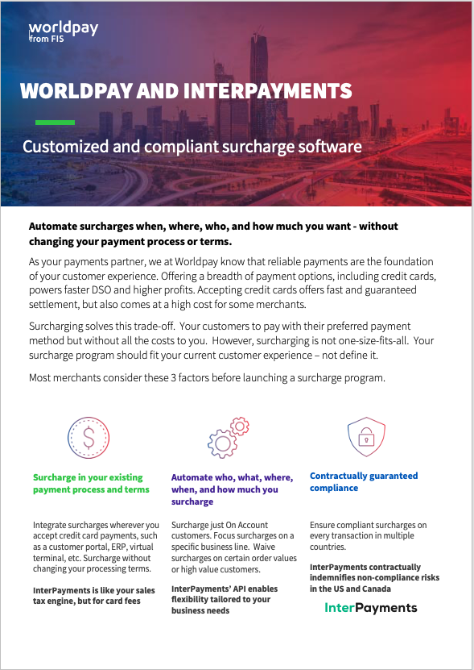
Resources & Next Steps
Resources
Data Sheet
Case Study
Partner Resource Library
Intro Email
Q3 SPIFF
$500 for leads that result in a call and MNDA
$1,500 for closed deal
Questions and opportunities:
partners@interpayments.com
Register opportunities here: Deal registration form

Slide 13
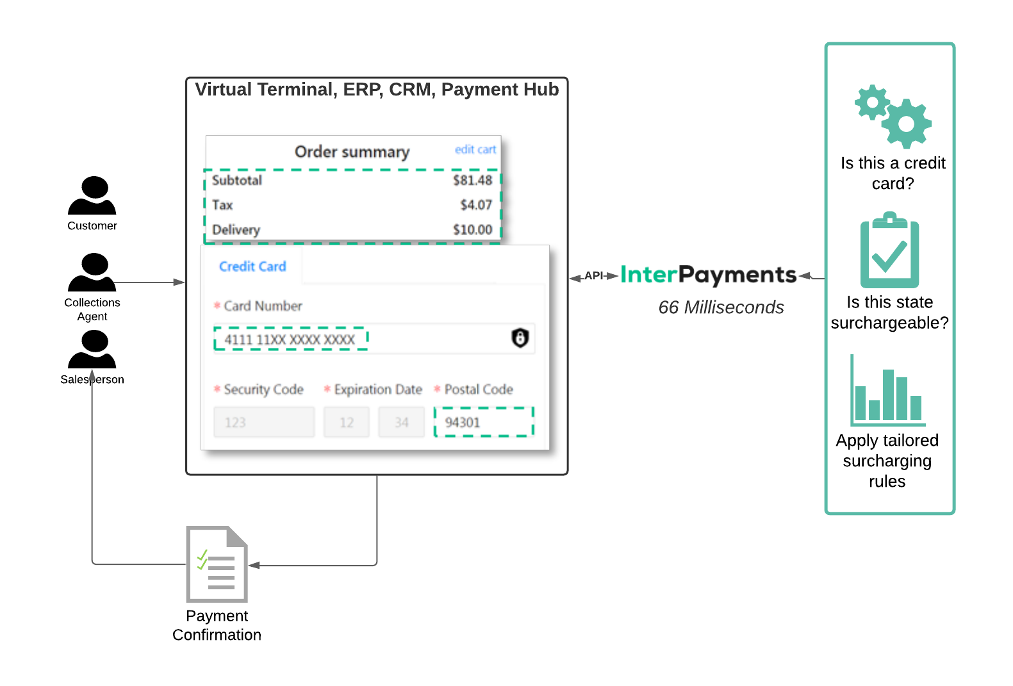
InterPayments works like sales tax, but for card fees
Real-time dynamic surcharging before payment authorization
1
Cardholder enters first 8 or 6 digits of card
2
InterPayments calculates exact compliant rate
Cardholder authorizes payment or switches to cheaper payment method
3
Payment reconciles in accounting like any other transaction
4
13

Slide 14
Appendix Thank You
partners@interpayments.com

Slide 15
B2B merchants are tired of credit card fees
63%
B2B merchants who want an easy surcharging solution
15%
B2B merchants who currently surcharge to offset fees
15
Source: October 24, 2019 NACM/WorldPay Survey

Slide 16
Joint Value Proposition
Challenge
Companies rely on digital payments for growth and expansion. Credit card acceptance shortens DSO, guarantees funds, and speeds up settlement, delivering incredible value to both the merchant and the payer. This convenience comes at a high cost to the merchant as processing fees continue to rise.
Solution
By combining Worldpay’s intelligent payment solutions with InterPayments’ embedded surcharging technology, companies can take control of their credit card and SUA processing fees without changing anything in their payments process.
Result
Customized and compliant surcharging across all your payment channels.
Integrated with your existing payment and accounting system.
Full control over who and how much you want to surcharge each customer.
Tangible value and immediate ROI

Slide 17
InterPayments Overview
Surcharging software service
Like your sales tax engine, but for credit card fees
Precise
Customized
Integrated
Compliant
Surcharge wherever you accept payments, without changing your payment vendors or terms
Surcharge who, what, and how much (like On Account vs. COD orders)
Embedded into your existing payment & accounting process
Contractually guaranteed compliance with the 67 surcharge regulators

Slide 18
Surcharging is not one-size-fits-all
Tailor surcharging to your business with InterPayments
On Account vs. COD
Specific Customers
Specific Order Values, Product Lines
Certain Locations
Surcharge lowest margin orders
Set surcharge rates by early payment discount periods
Surcharge by customer type or payment method
Avoid surcharging top customers and SUA card payers
Surcharge by order size or product
Set surcharging by order value, product line, or business unit
Surcharge certain locations or payment channels
Allow general managers or sales agents flexibility to surcharge
18

Slide 19
Case Study: Supplier recovers $360k in <30 days
Annual Fee Recovery
~$3 million
Surcharged Payment channels
Online website & In Store
Background
Leading distributor of building materials with $2bn annual total revenue
Goals
Improve net margins
Outsource surcharge compliance and risk
Keep current PSPs and terms in place
Integration
Installed InterPayments API on website and in store payment interfaces over 2 months. Used internal development team.
Payment vendors
Maintained their CyberSource payment gateway and existing processing terms
1st 30-days Recovery
$360k
Surcharge customizations
No sample orders Certain customers
Surcharged AOV $ Range / Avg.
$1 – 10k ($1.5k avg)
Surcharged Payment Methods
Credit & SUA/P/Virtual Cards
19

Slide 20
Why work together?
Unique Market Opportunity
Differentiate your offering and deliver massive cost savings opportunity.
Deepen Relationships
Provide tangible value and expand your footprint in accounts.
Hit Sales Targets
Increase revenue with existing accounts. Share account intelligence to help accelerate and close deals faster.

